Slide 1
We

Slide 2
are

Slide 4

CASE
STUDIES

Slide 5
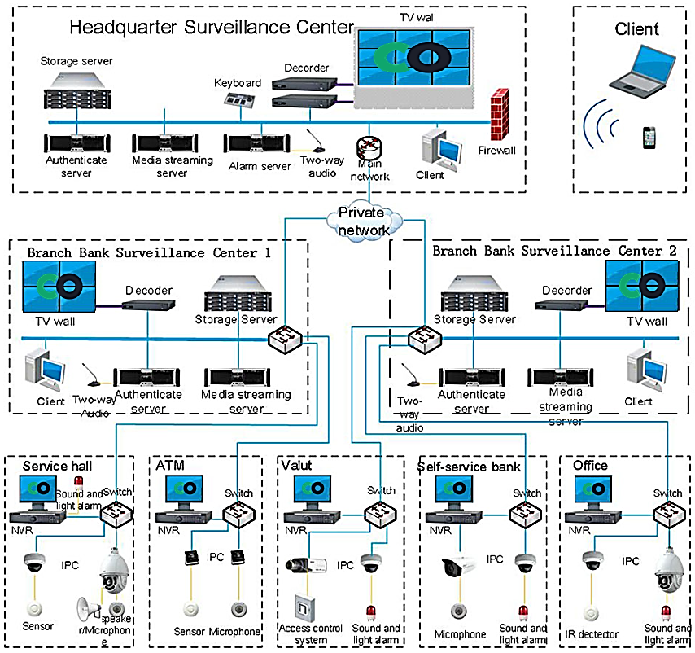
Bank Solution

Slide 6
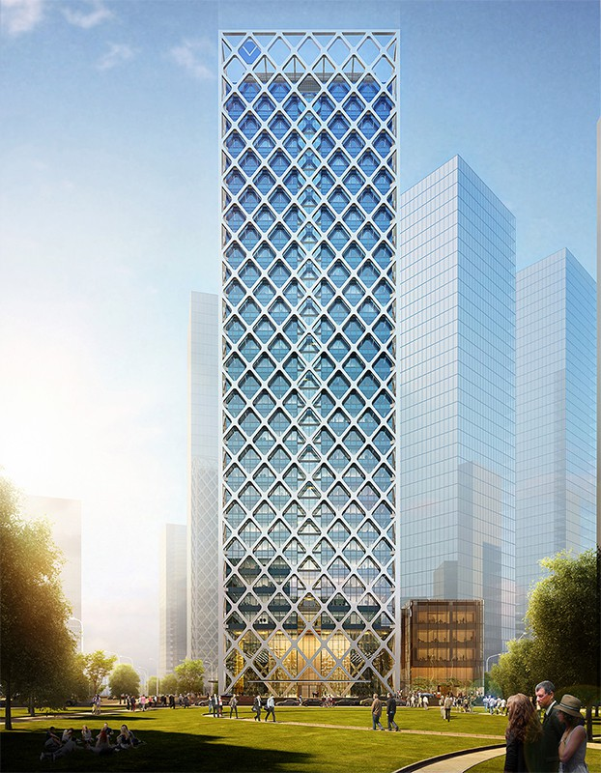

Shenzhen Rural Commercial Bank Project, China

Slide 7
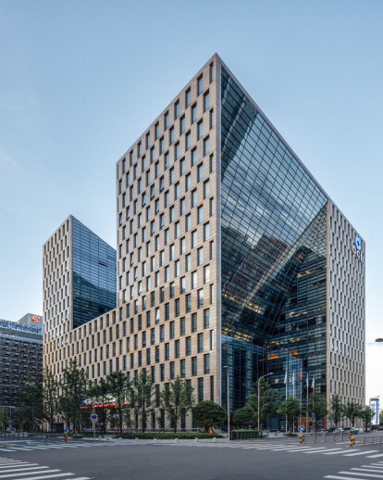

Construction Bank of China Project

Slide 8
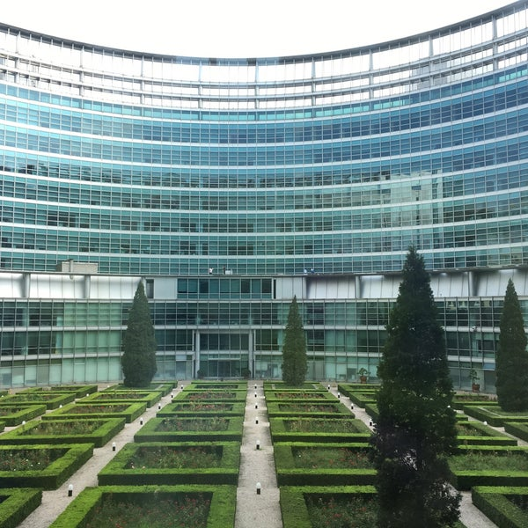
Industrial Bank Co.; Ltd Project of China

Slide 9
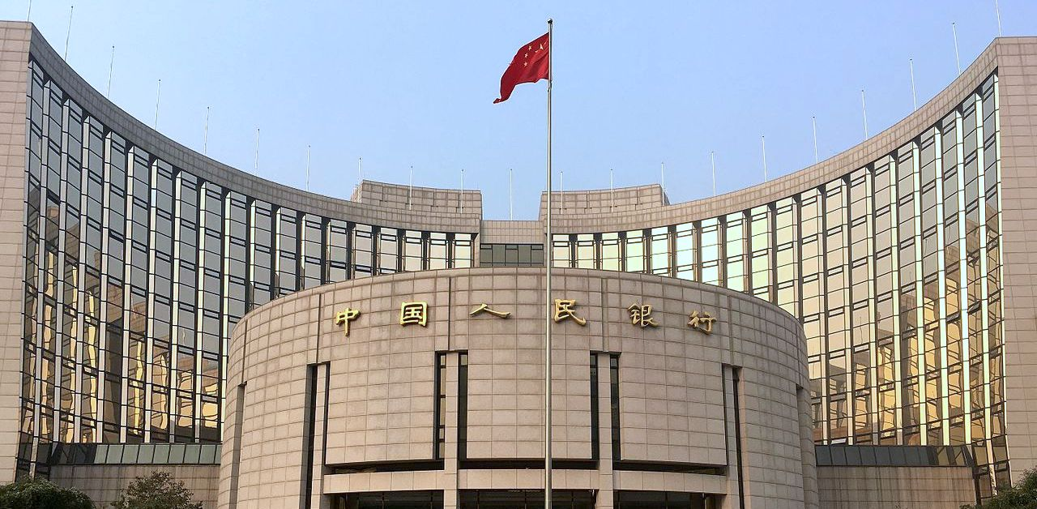
The People's Bank Of China Project

Slide 10

RVD
365+

Slide 11
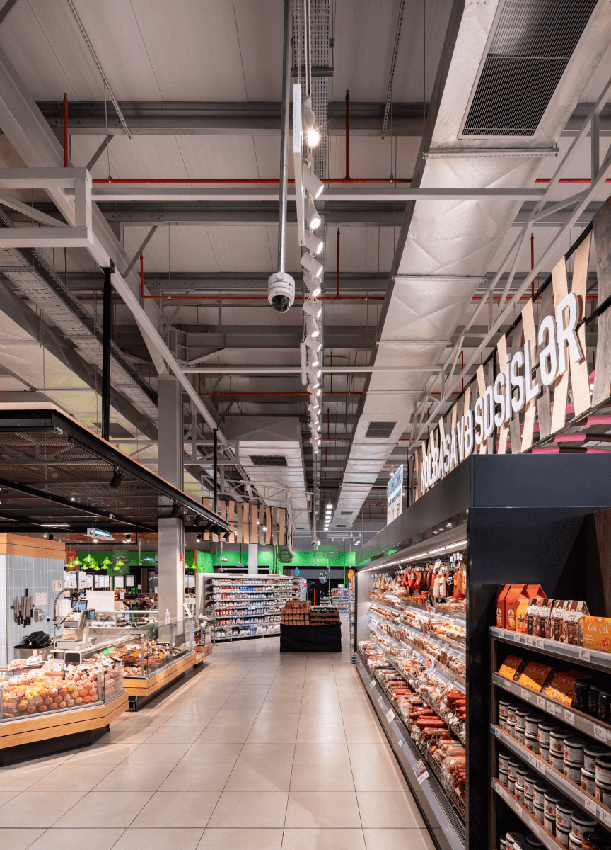

Baku, Azerbaijan
GRAND HYPERMARKET
2605
38
CAMERAS
NVR

Slide 12
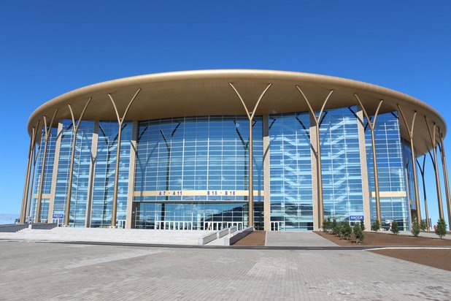
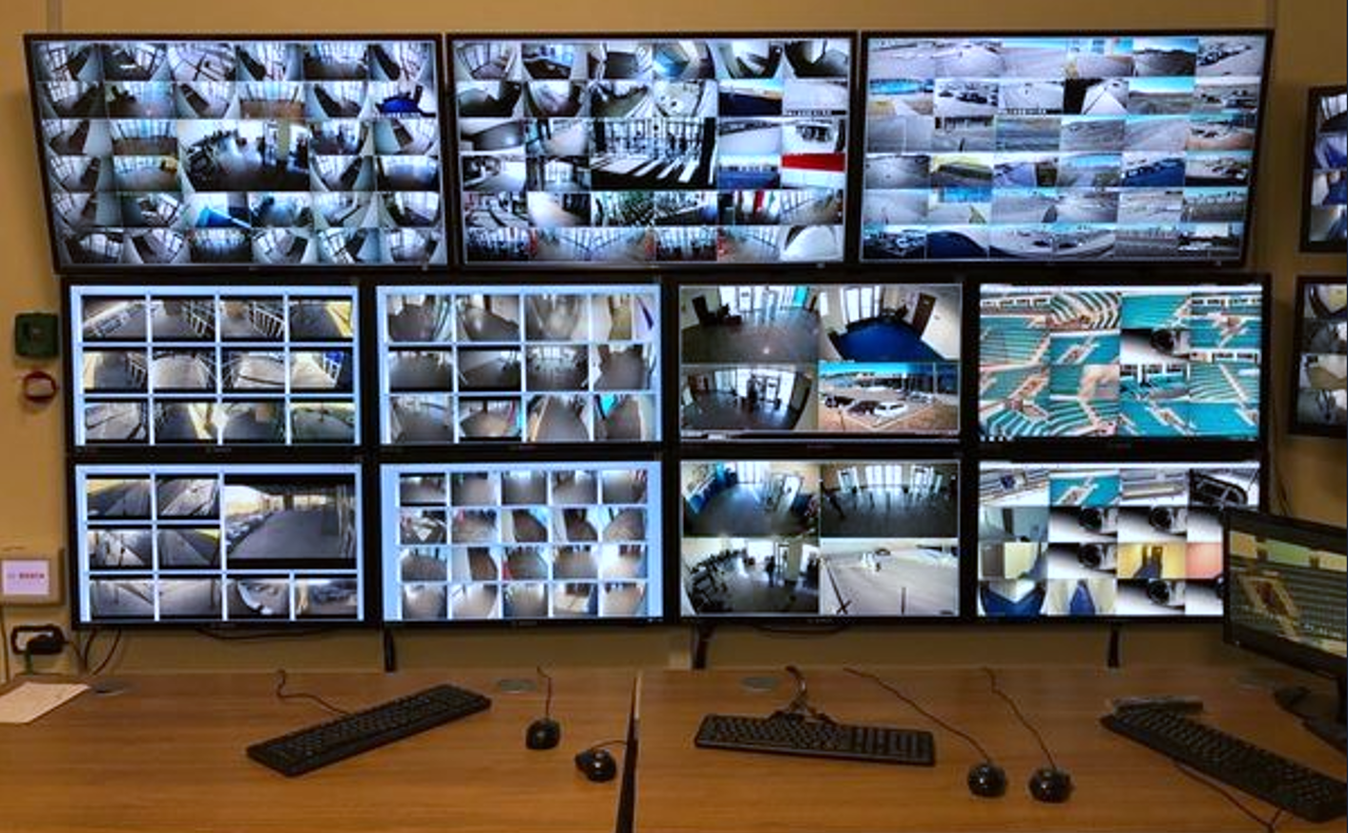
Hockey arena in Kazakhstan
2009
12
CAMERAS
SERVERS

Slide 13
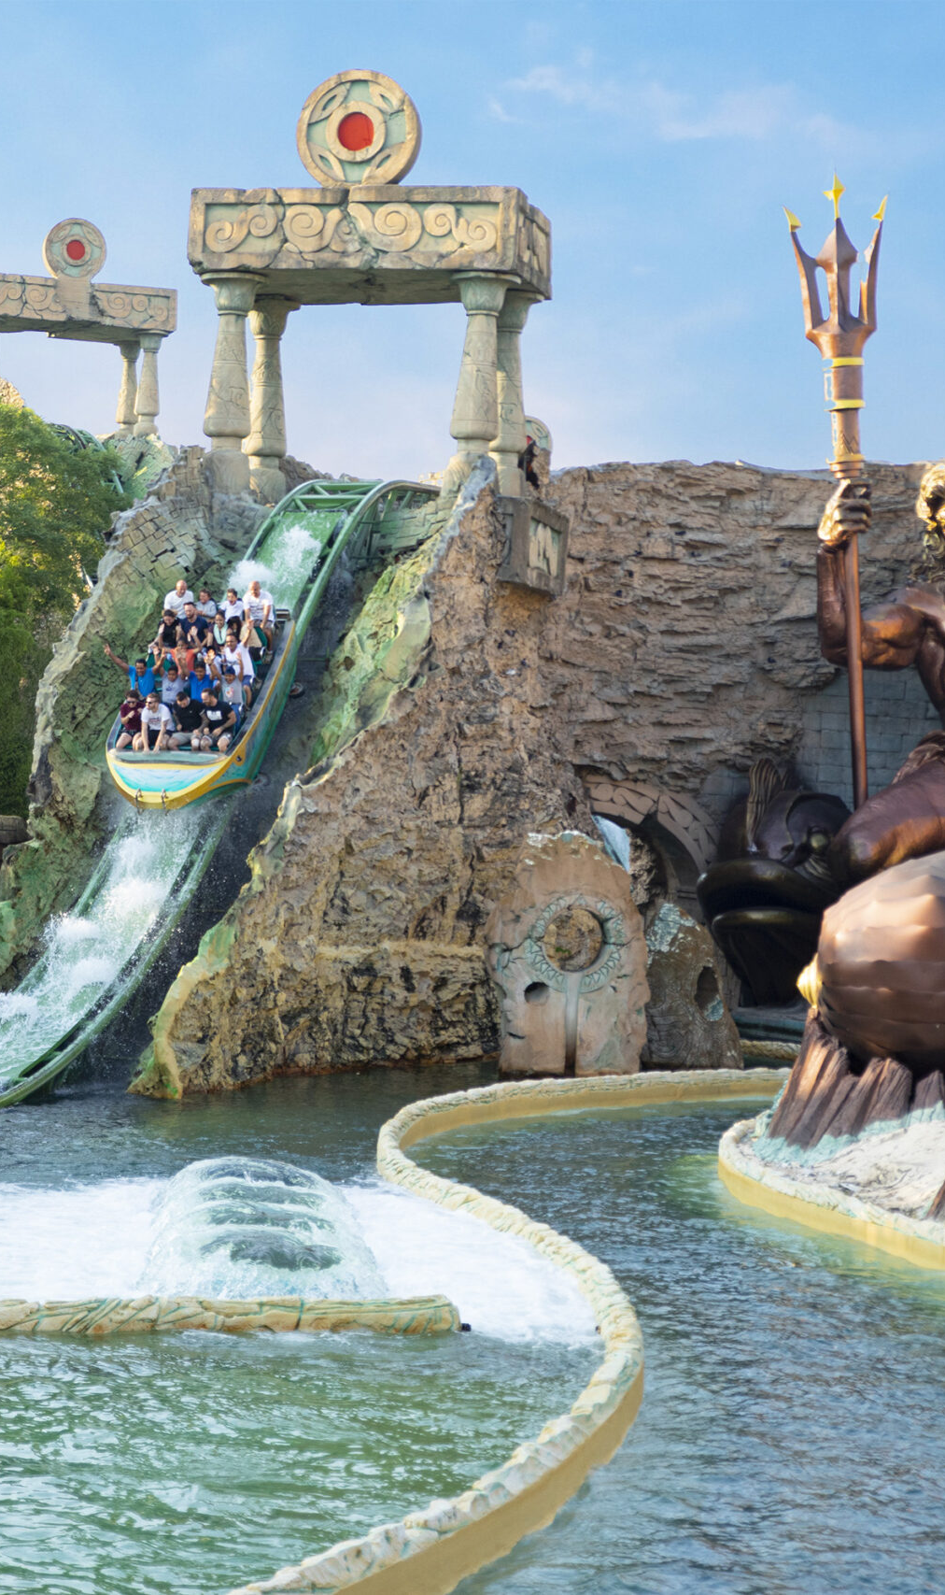
Italy’s biggest and finest amusement park
GARDALAND
CASTELNUOVO DEL GARDA (VR)
632
6
60
CAMERAS
NVR
DVR
3.070.000
VISITORS (2023)

Slide 14
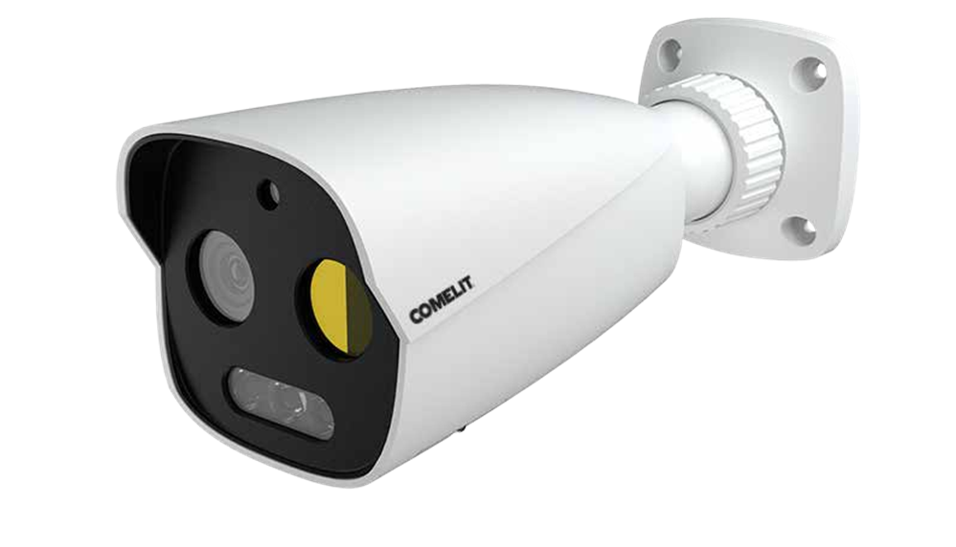
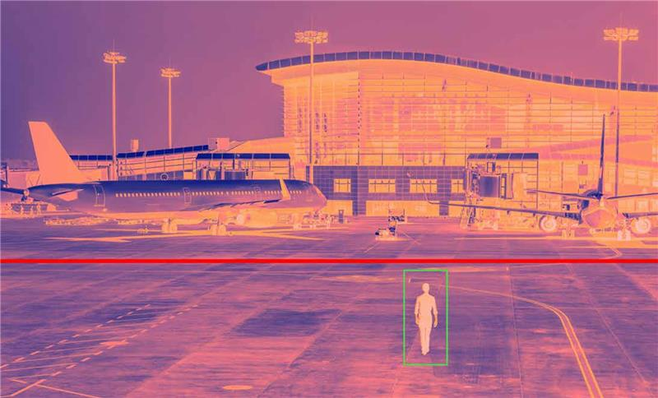
ADVANCE
PROJECT

Slide 15
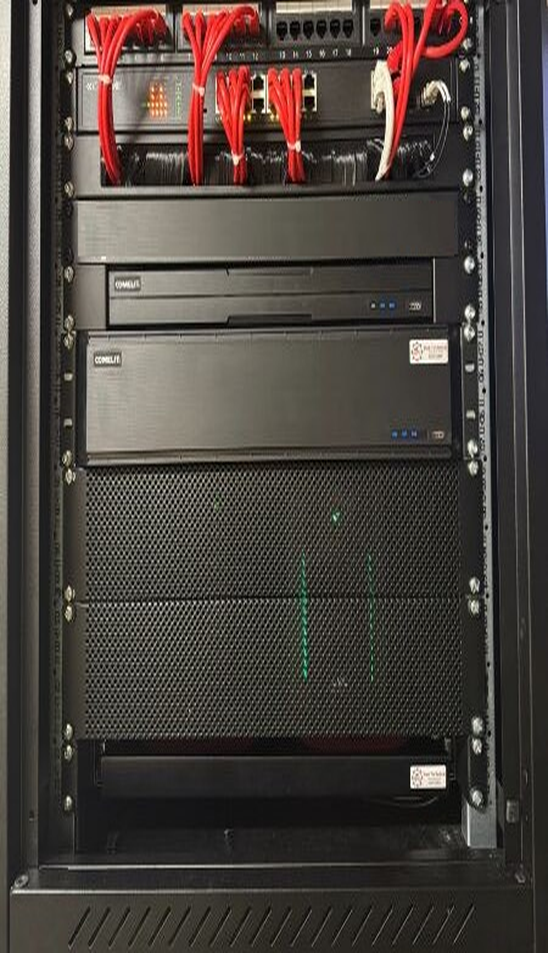
Andover's Shield: Feel Secure
Test Valley Borough Council - Andover (Hampshire UK)
2
32
SERVER
CAMERAS, ANPR, PTZ

Slide 16
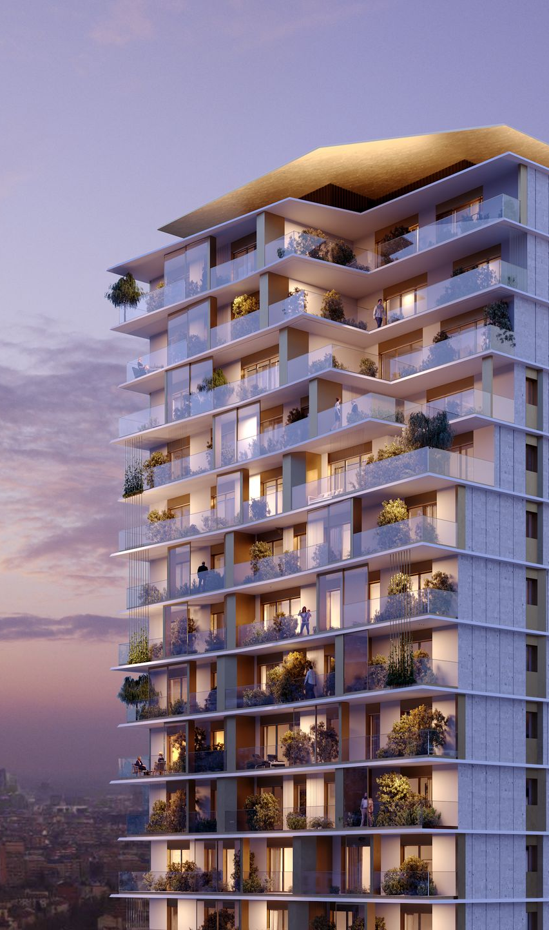
The first Italian smart district
FEEL UPTOWN
VIA PIER PAOLO PASOLINI, 3, 20151 MILAN
+600
APARTMENTS ON MULTIPLE TOWERS, CONNECTED WITH IP TECHNOLOGY. COMELIT AT 360 °!

Slide 17

INTERPOL GdF South of Italy
REGIONAL COMMAND GdF
PALERMO (ITALY)
132
2
6
CAMERAS
NVR
LED CONTROL ROOM

Slide 18
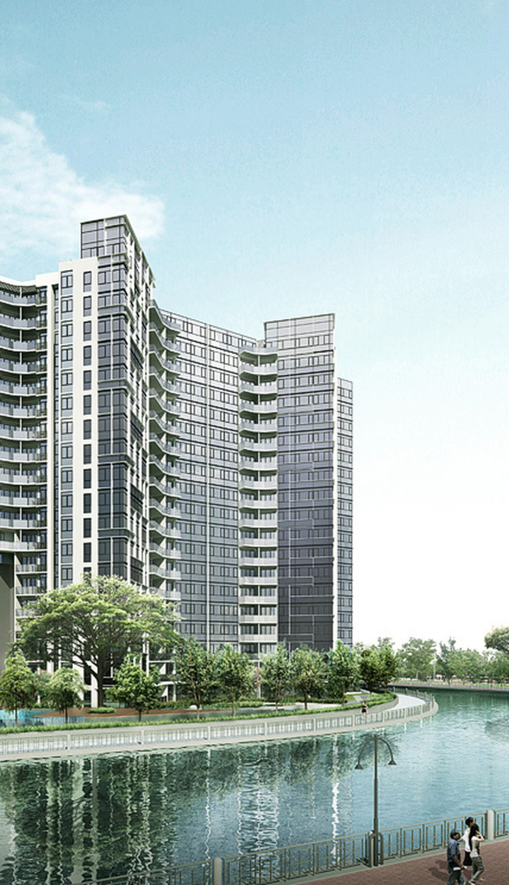
UOL GROUP – WATERBANK @ DAKOTA
72 Dakota Crescent, Singapore
27
53
2
DOME IP
CAMERAS
BULLET IP CAMERAS
2 SET OF
32CH NVR

Slide 19
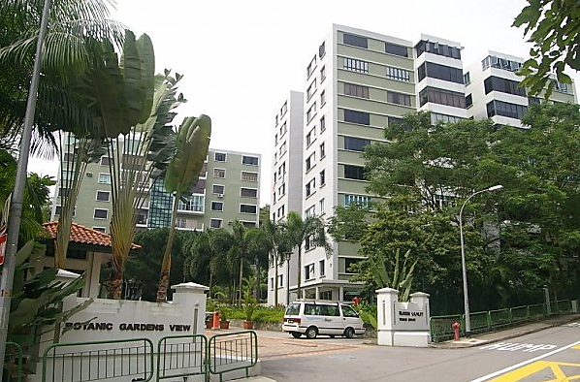
YAT YUEN HONG – BOTANIC GARDEN VIEW
9 TAMAN SERASI, SINGAPORE
10
15
2
DOME IP
CAMERAS
BULLET IP CAMERAS
2 SETS OF
16CH NVR
2
SETS OF 24’’
MONITORS

Slide 20
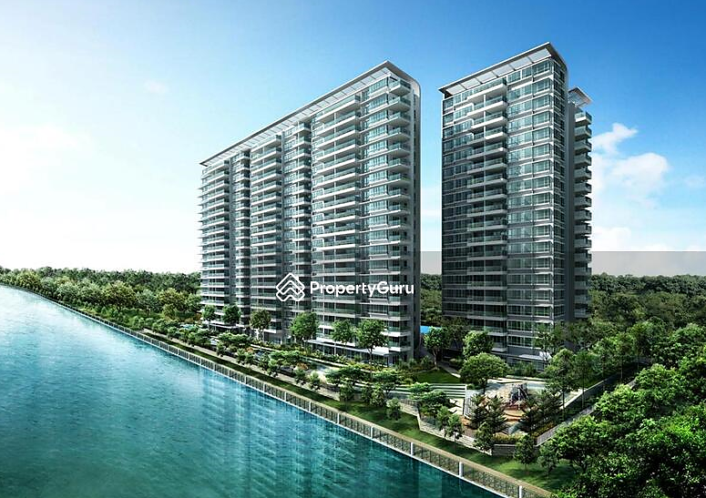
Ho Bee Land – Dakota Residence
42 DAKOTA CRESCENT, SINGAPORE
73
37
3
IP DOME
CAMERAS
IP BULLET CAMERAS
2 SET OF
36CH NVR
4
SETS OF
24’’ MONITORS

Slide 21
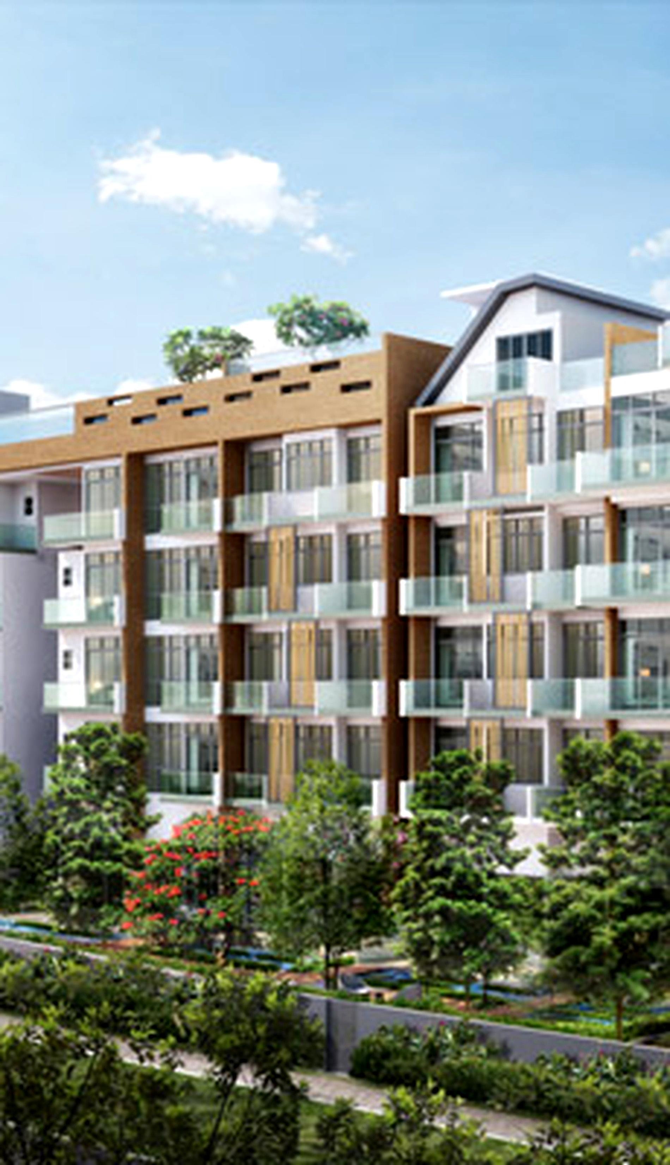
Meadows Investment
Gambir Ridge
16 GAMBIR WALK, SINGAPORE
22
19
2
IP DOME
CAMERAS
IP BULLET CAMERAS
2 SET OF
32CH NVR
2
4
SETS OF 32’’
MONITORS
IP LPR CAMERAS

Slide 22
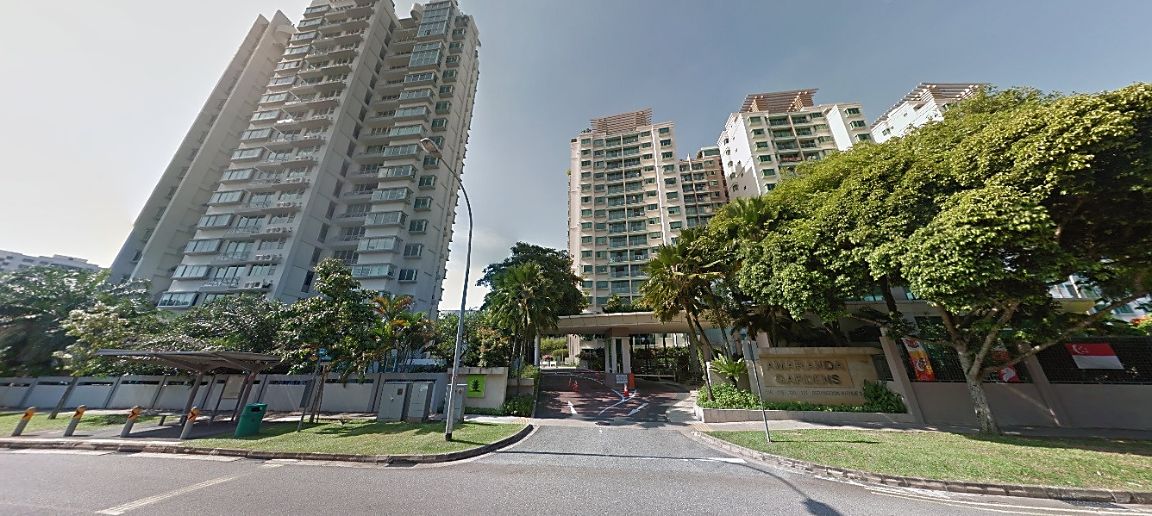
KEPPEL LAND
AMARANDA GARDENS
118 SERANGOON AVENUE 3, SINGAPORE
7
30
2
IP DOME
CAMERAS
IP BULLET CAMERAS
2 SET OF
32CH NVR
2
2
SETS OF 32’’
MONITORS
SETS OF 24’’
MONITORS

Slide 23

COMMERCIAL PARK
CLOSE DU CHENE
Av. de la Frm Briarde, 77144 Montévrain, FRANCE
50
70
1
IP DOME
CAMERAS
IP BULLET CAMERAS
128CH NVR

Slide 24

FOYER REMOIS: 22,600 homes and more than 35,000 clients
SOCIAL LANDLORD - FRANCE
3rd party
CAMERAS
VMS
XVR
COMELIT CCTV MANAGER
ALL BUILDINGS WITH SEVERAL XVR

Slide 25
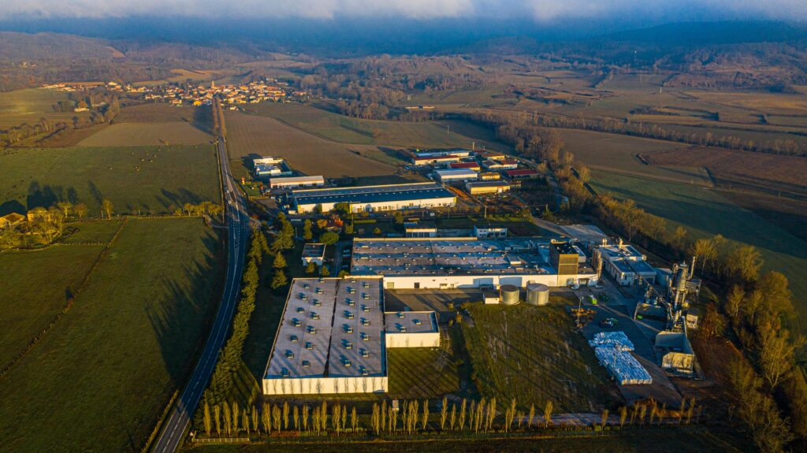
One of the world's most important construction factories
ACTIS LIMOUX, FRANCE
150
3
IP BULLET CAMERAS
64CH NVR
40,000 s.m.

Slide 26
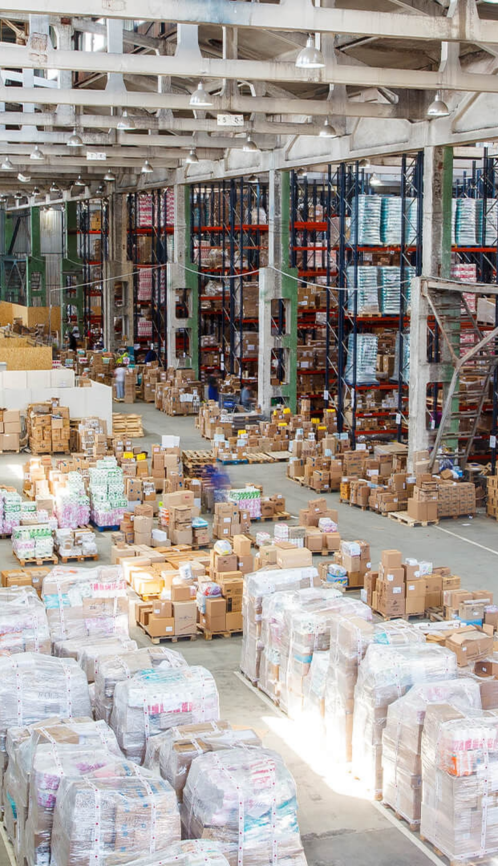
A great European storage space specialist
OPSLAGMAN, THE NEDERLANDS
+2000
IP CAMERAS THROUGHOUT THE COUNTRY

Slide 27
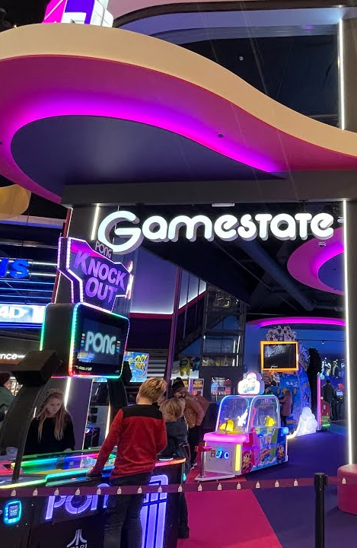
Gamestate
More then 15 locations across Europe
+1500
IP CAMERAS THROUGHOUT Europe

Slide 28
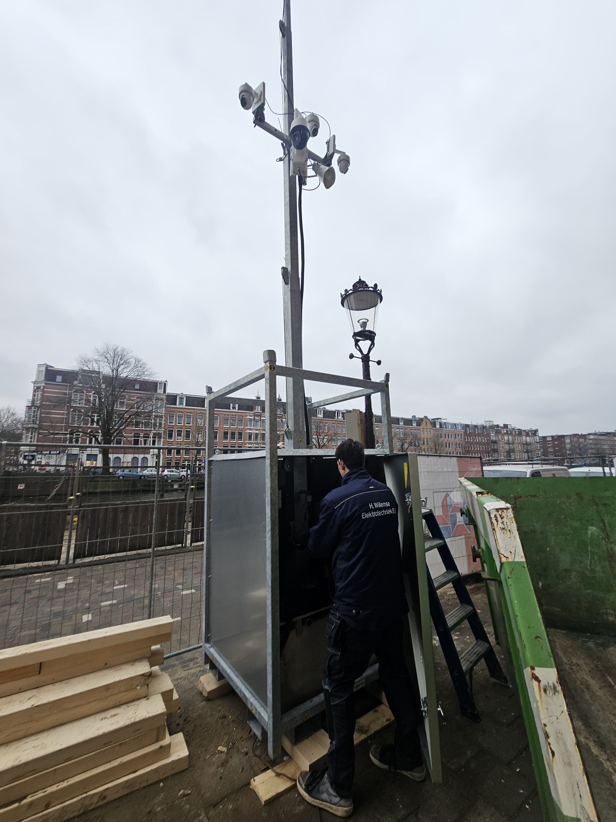
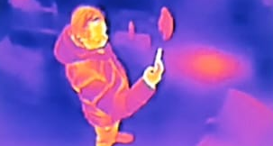
Flexible construction site security
10 CCTV Towers deployed over The Netherlands
10
30
10
PTZ camera’s
Bispectrum thermal turret camera’s
4CH NVR’s

Slide 29
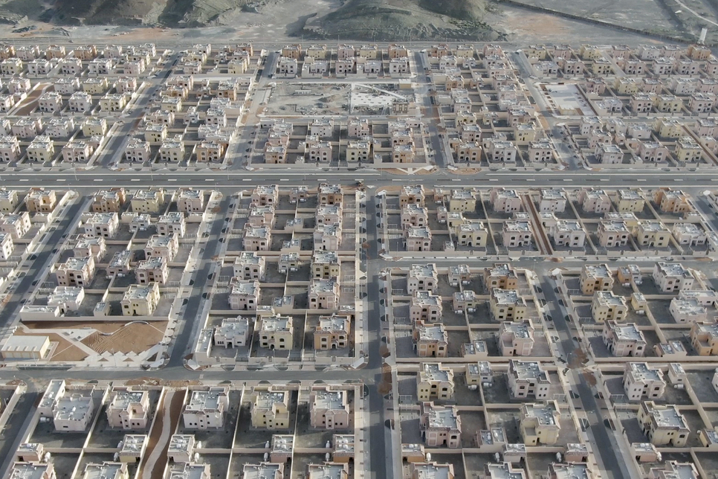
A VISIONARY RESIDENTIAL COMPLEX
MBZ CITY - FUJAIRAH
250
4
1
IP BULLET
CAMERAS
4K PTZ
CAMERAS
ADVANCE VMS &
FAIL OVER SERVER
3
STORAGE SERVERS

Slide 30
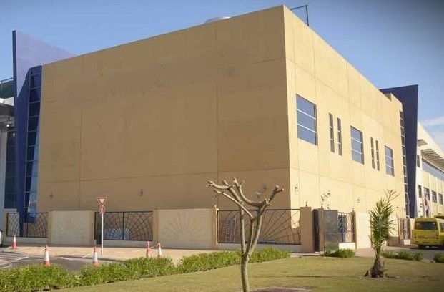
One of the world's most important international college
INTERNATIONAL COMMUNITY SCHOOL
ABU DHABI - UAE
139
2
1
IP BULLET CAMERAS
64CH NVR
32CH NVR

Slide 31
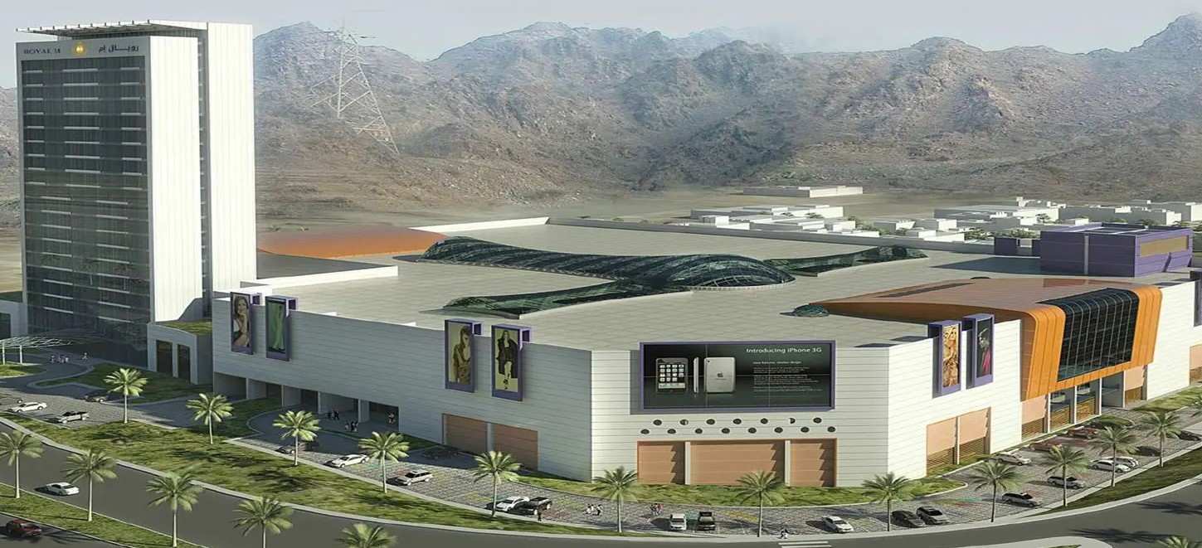
AN ICONIC MALL IN UAE
MALIHA - FUJAIRAH
100
2
IP BULLET
CAMERAS
ADVANCE VMS &
FAIL OVER SERVER
2
STORAGE SERVERS

Slide 32
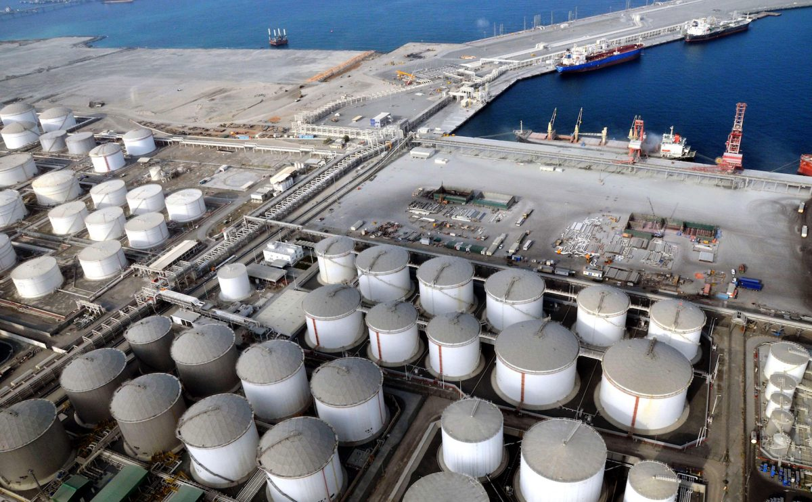
OIL INDUSTRY
AL HILAL CITY - FUJAIRAH
35
2
2
4K PTZ
CAMERAS
ADVANCE VMS &
FAIL OVER SERVER
STORAGE SERVERS

Slide 33

Thank You

